Slide 1

ResQ-Notify Revolutionizing Road Safety with AI-Powered Crash Detection and Emergency Response
AIProStack Solutions

Slide 2

Problem Statement
When accidents happen on the road, the way we currently report them and get help is slow and less efficient. This means that people sometimes suffer for longer, and even lose their lives when they could have been saved. We need a new way of doing things that uses technology to make it better.
Imagine if we could use the cameras already in our vehicles, like dash cams or Go Pros, to do more than just record videos. We want to make these cameras smart using AI so they can quickly spot accidents as they happen. This way, we can get help to the scene much faster and make accidents less serious.

Slide 3


Social Impact
Golden Hour: Rapid medical attention within the "golden hour" after a road accident increases survival chances and reduces long-term disabilities.
Response Time Impact: Delays in emergency response raise fatality risk by 19%.
Automobile theft control: The model has the car/bike location and video from the cam that can help police track thief.

Slide 4

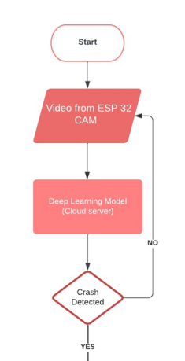
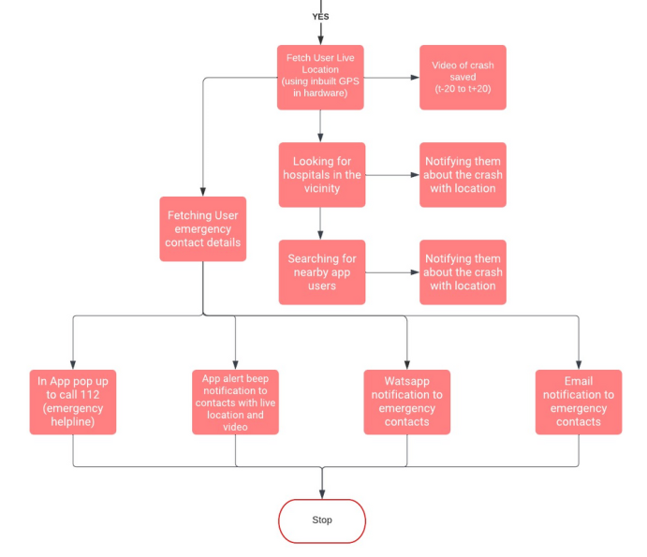

Solution Flowchart

Slide 5
Detail Explanation
Integration: ResQ-Notify is integrated with your vehicle's dashcam/go-pro or the ESP32-CAM microcontroller board, capturing real time video footage.
Deep Learning Model: Our deep learning model(trained to detect crashes) on the server will take the real time video as input.
Crash Detection: If a crash is detected, then our emergency response system will get active.

Slide 6

Emergency Response System
In this, the user location and video of crash will be sent to the user via a email notification, WhatsApp message and a in app alert.
The system will search and notify hospitals and police stations in the vicinity using the user’s live location.
The system will also notify any nearby ResQ-Notify users to save the user.

Slide 7
Tech Stack
AI MODEL: CNN Deep Learning Model
Database: Firebase and MongoDB
Frame work: Flutter
Languages: Python and Dart
API Frame work: Fast API
Hardware: ESP32 Dash cam with WIFI Module

Slide 8
PERKS OF OUR SYSTEM
Q4 2024
Instant Emergency Response Reduce Response Time
Automated Multi-Channel Alerts
Car/bike real time theft vehicle location
Real Time Location and video Of Crash
Easy and affordable Hardware Integration
SOS Service

Slide 9
FUTURE POTENTIAL AND SCALABILITY
Advanced Sleep Alert System: Our future roadmap includes an innovative alert system that detects user distractions or drowsiness, enhancing proactive safety measures and preventing potential accidents.
Predictive Analytics: Harnessing data insights, our technology has the potential to predict accident-prone areas, enabling proactive measures and targeted safety interventions.
Collaborative Partnerships: Collaborations with insurance companies could lead to usage-based premiums, incentivizing safer driving practices and rewarding responsible behavior.

Slide 10
USER BASE
Personal Safety use: Our technology seamlessly integrates with personal safety apps, enabling automatic crash detection, distress signal transmission, and instant notifications to emergency contacts, ensuring rapid assistance.
Vehicle Companies: Car manufacturers can seamlessly incorporate our cutting-edge crash detection system into their vehicles, prioritizing driver and passenger safety by providing real-time incident identification and triggering immediate emergency response measures.
Law Enforcement and healthcare Agencies: Police departments and law enforcement agencies can harness the capabilities of our system for precise crash detection and immediate notifications. This support facilitates prompt accident response, aids investigation processes, and streamlines documentation efforts.

Slide 11

Thank You
You can reach out us at aiprostacksolutions@gmail.com
As always, we're open for questions
AIProStack Solutions
AIProStack Solutions

